Slide 1


Sensing Temperature through Raspberry Pi3
Data Communication Project
Course Instructor: Dr. Thejaswini M

Slide 2
Project Team Members
Sumit Kumar Kushwaha (170101050)
Sunny Kumar (170101051)
Suraj Kumar (170101052)
Suraj Kumar (170101053)
Vipul Kumar (170101054)
Hitesh Kumar Sahu (170102019)
Kanishka Tyagi (170102021)
Rashi Krishna (170102037)

Slide 3
Project Objective:
The goal of the project is to create a Secure and Reliable IoT device that can sense temperature of surrounding atmosphere, using Raspberry pi3 and temperature sensor. The user will be notified of specified changes in the temperature.

Slide 4
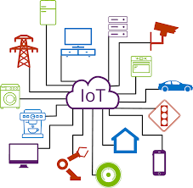
Internet of Things:
The Internet of Things (IoT) is the inter-networking of physical devices, vehicles (also referred to as "connected devices" and "smart devices"), buildings, and other items—embedded with electronics, software, sensors, actuators, and network connectivity that enable these objects to collect and exchange data. IoT allows objects to be controlled and gather information remotely across the already established network

Slide 5
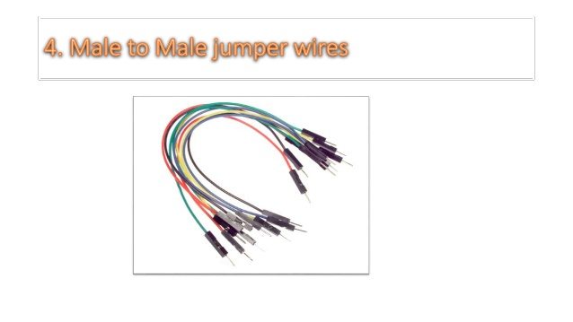
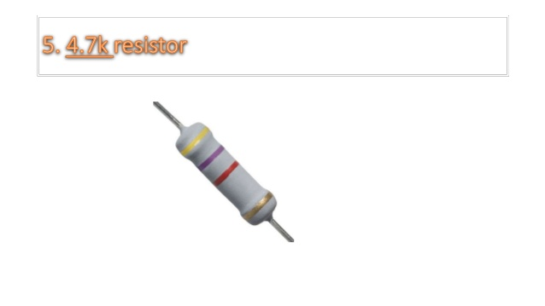
Requirements
One Raspberry Pi3
Temperature Sensor
5. Resistor(4.7k)
3. Display
4. Jumper wires

Slide 6
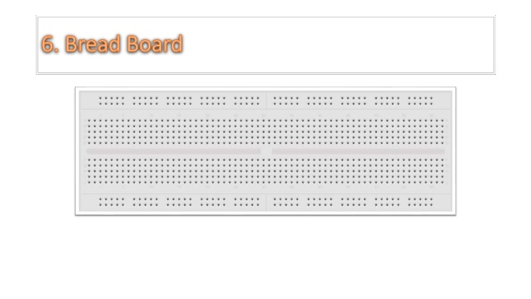
Bread Board

Slide 7
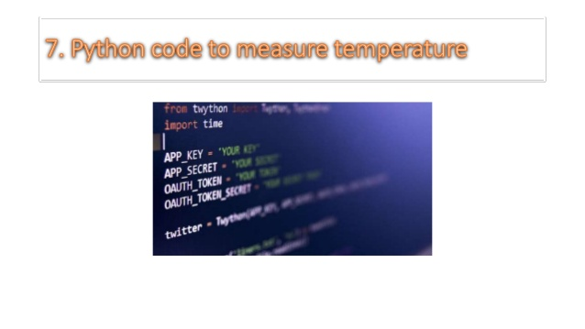
Python code to measure

Slide 8
Component Definition:
Hardware
Software
Server
Raspberry Pi Model B
Control and monitor
Sensor
Send data to server for user access
Putty : give network access to raspberry pi
Rasbian os used in raspberry pi
Xming server : used to project raspberry pi os into our laptop

Slide 9
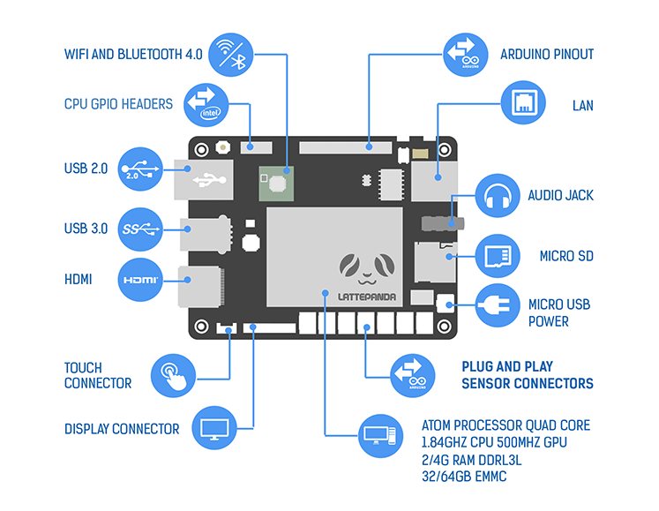
Blue print of Raspberry pi3:

Slide 10
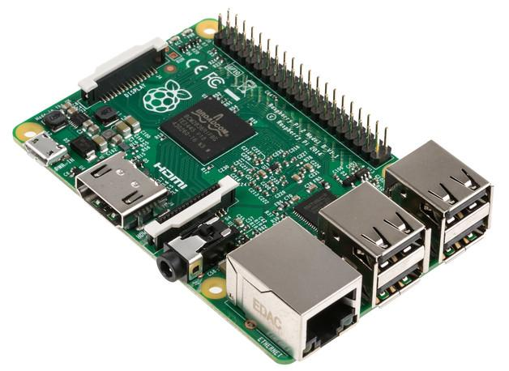
Raspberry pi3
Allows multiple programs to be run at once
Simple implementation of even large systems
Many GPIO connection pins

Slide 11
Raspberry pi3
Raspberry Pi is a small single board computer. By connecting peripherals like Keyboard, mouse, display to the Raspberry Pi, it will act as a mini personal computer.
Raspberry Pi is popularly used for real time Image/Video Processing, IoT based applications and Robotics applications.
Raspberry Pi is slower than laptop or desktop but is still a computer which can provide all the expected features or abilities, at a low power consumption.

Slide 12
Raspberry pi3 Contd…
Raspberry Pi Foundation officially provides Debian based Raspbian OS. Also, they provide NOOBS OS for Raspberry Pi.
We can install several Third-Party versions of OS like Ubuntu,RISC OS, Windows 10 IOT Core, etc.

Slide 13
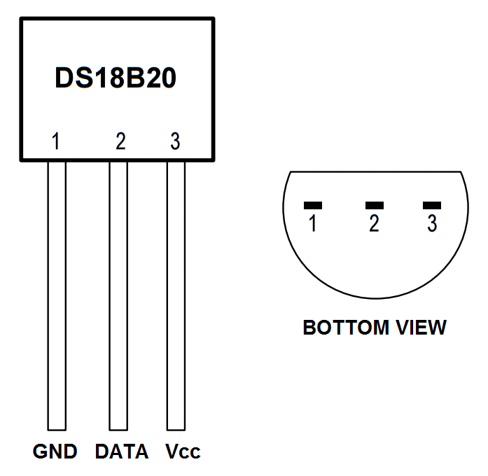
Temperature Sensor:
DS18B20 Digital Temperature Sensor

Slide 14
DIGITAL TEMPERATURE SENSORS:
Digital temperature sensors are typically silicon based integrated circuits.
Most temperature sensor contains an analog to digital converter (ADC).
Memory to temporarily store the temperature readings, and an interface that allows communication between the sensor and a microcontroller.
Calculations are performed by the sensor, and the output is an actual temperature value.

Slide 15
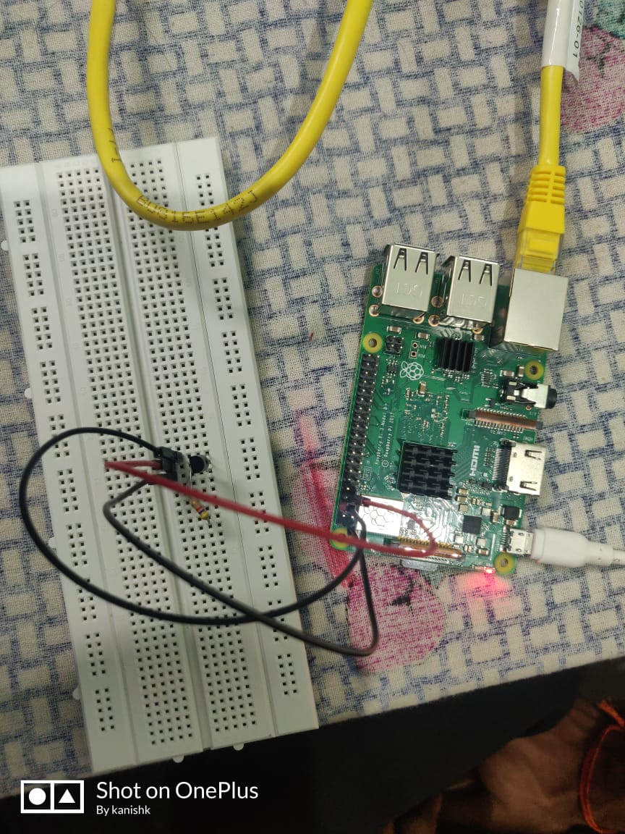
Hardware Implementation:

Slide 16
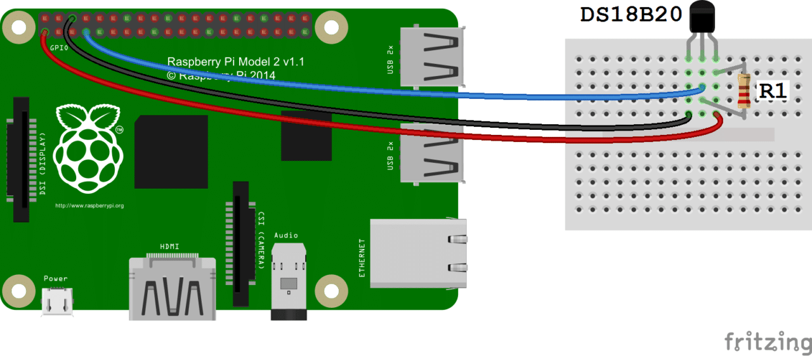
Implementation

Slide 17
Steps:
1. First, connect the 3v3 pin from the Pi up to the positive rail & a ground pin to the ground rail on the breadboard.
2. Now place the DS18B20 sensor onto the breadboard.
3. Place a 4.7k resistor between the positive lead and the output lead of the sensor.
4. Place a wire from the positive lead to the positive 3v3 rail.
5. Place a wire from the output lead back to pin #4 (Pin #7 if using physical numbering) of the Raspberry Pi.
6. Place a wire from the ground lead to the ground rail.

Slide 18
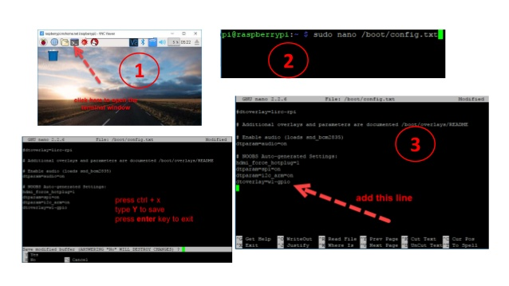
Software Implementation:

Slide 19
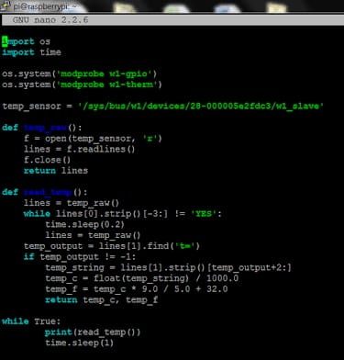
Python Code to measure temperature:

Slide 20
Code:
import os
import glob
import time
os.system('modprobe w1-gpio')
os.system('modprobe w1-therm’)
base_dir = '/sys/bus/w1/devices/'
device_folder = glob.glob(base_dir + '28*')[0]
device_file = device_folder + '/w1_slave'
def read_temp_raw():
f = open(device_file, 'r')
lines = f.readlines()
f.close()
return lines

Slide 21
Code contd:
def read_temp():
lines = read_temp_raw()
while lines[0].strip()[-3:] != 'YES':
time.sleep(0.2)
lines = read_temp_raw()
equals_pos = lines[1].find('t=')
if equals_pos != -1:
temp_string = lines[1][equals_pos+2:]
temp_c = float(temp_string) / 1000.0
temp_f = temp_c * 9.0 / 5.0 + 32.0
return temp_c, temp_f
while True:
print(read_temp())
time.sleep(1)

Slide 22
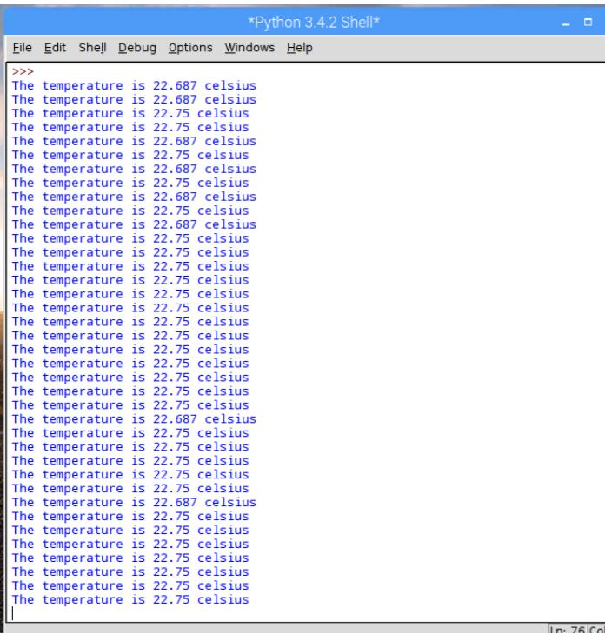
Output:

Slide 23
Conclusion:
In conclusion, the Raspberry Pi performs well as a device which monitors environmental conditions.
It can also be repurposed if needed to complete other tasks and be used possibly for other unrelated projects, therefore it is cost effective to a company who possesses them.
The task the Raspberry Pi had to complete during this current project was to monitor the environment, temperature and report this information . It does this task efficiently; the sensors and hardware are easily installed to modify it to perform as such.

Slide 24
Conclusion Contd..
The Raspberry Pi’s performance as a sensor device was flawless, any problems that were encountered were down to other factors such as internet or human error with the coding and database.
The Raspberry Pi is an affordable device that can do so much from a weather station to a home security device, there are so many different sensors out there and with IoT gaining more popularity who knows where the Raspberry Pi and its sensors will evolve.

Slide 25
Advantages:
Low cost
Size and portability
Low power consumption
Most of the software is free or open source this allows for learning expansion
It allows direct accessible processor pins through GPIOs
Has a simple server for light internet traffic
Great for prototyping

Slide 26
Disadvantages:
Demands knowledge of Linux.
Coding can be difficult.

Slide 27
Future Aspects:
This system could eventually evolve in to a full weather system, by adding more sensors.
Placing it outside, by taking the outside weather into account and measure how much the temperature and humidity inside the building.
It could be permanently installed in a building as a temperature and humidity measure, with sensors in each room.

Slide 28
Future Aspects Contd..
This system could be applied in the health care sector, schools or domestic settings where temperature and humidity measurements are required.
It could also be developed further to provide an alarm or notification that unhealthy or unwanted conditions are detected.

Slide 29
Thank You!

